Slide 1

SUMMER INTERNSHIP REPORT
Analysis & Design of Vehicle Chassis in EV’s
Submitted by:
238T5A0202-ANNAVARAPU KOTESWARA RAO
238T5A0203-ARIGA PREM KUMAR
238T5A0211-PULAVARTHI SURESH.
Faculty Mentor:
Dr. GUVURULA NAIDU
ASSISTANT PROFESSOR & HEAD OF THE DEPEARTMENT
ELECTRICAL AND ELECTRONICS ENGINEERING
(Batch No-1)

Slide 2
ABSTRACT:
Electric vehicles (EVs) are gaining popularity worldwide due to their environmental benefits, reduced operating costs, and improved performance. This paper provides an in-depth analysis of EVs, including their types, battery technologies, charging methods, and research challenges. We will explore the current market situation, future prospects, and the role of EVs in smart cities.

Slide 3
INTRODUCTION TO EV’s
History and Evolution EV’s
Classification of EV’s
Main Components in EV’s
Principle of Operation
Merits and Demerits
3

Slide 4
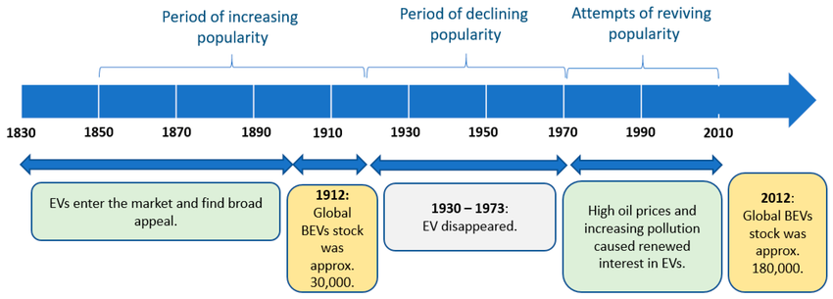
HISTORY OF EV’s:
Electric vehicles emerged in the 1830s, with Robert Anderson creating a crude electric carriage. Over the years, innovations and improvements led to the development of more practical EVs. In the late 19th and early 20th centuries, EVs gained popularity, particularly in urban areas. However, the rise of gasoline-powered vehicles and limitations in battery technology led to a decline in EV adoption.
4

Slide 5
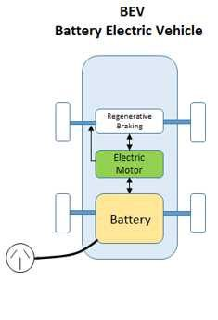
CLASSIFICATIONS:
1. Battery Electric Vehicles (BEVs) :
BEVs are powered by a battery pack and electric motor.
BEVs produce no emissions, reducing air pollution and greenhouse gas emissions.
BEVs can be recharged from an external power source, such as a wall socket or charging station.
BEVs offer a sustainable and environmentally friendly transportation option, with benefits including lower operating costs and reduced dependence on fossil fuels.
5

Slide 6
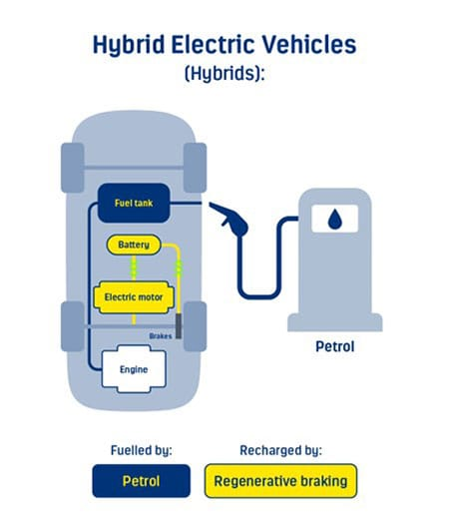
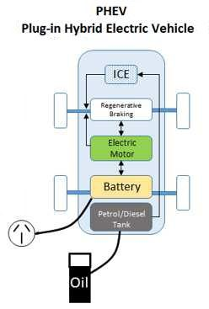
2. Hybrid Electric Vehicle:
HEVs have both an electric motor and a gasoline engine.
HEVs cannot be plugged into an external power source; instead, they recharge their battery through regenerative braking and engine power.
HEVs optimize fuel efficiency by using electric power to assist the gasoline engine.
3. Plug In Hybrid Electric Vehicle(PHEVs):
PHEVs have both an electric motor and a gasoline engine.
PHEVs can be plugged into an external power source to recharge their battery.
PHEVs can run on electric power alone for a certain distance, then switch to gasoline power for extended range.
6

Slide 7
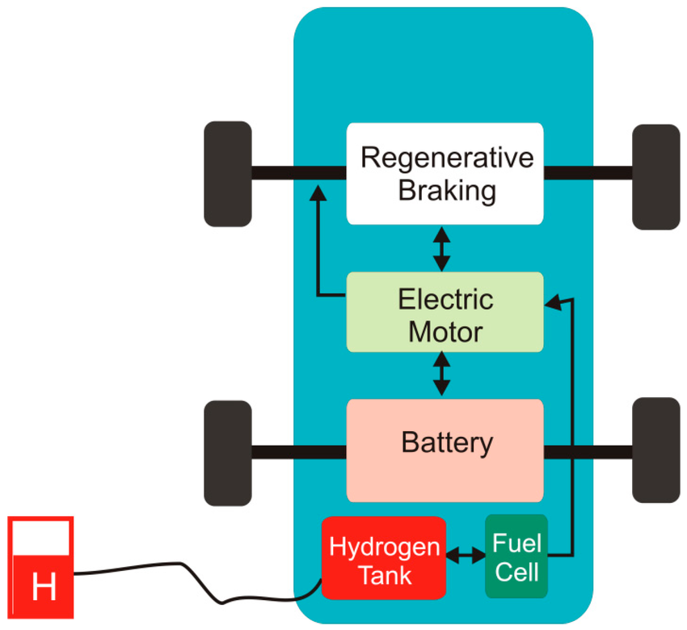
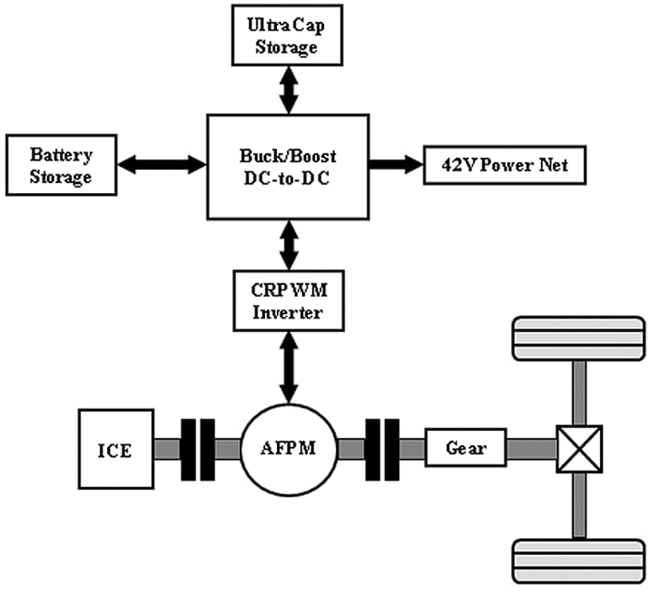
FCEV
4. Fuel Cell Electric Vehicle(FCEVs):
FCEVs generate electricity from hydrogen, which powers an electric motor.
FCEVs produce only water vapor and heat as byproducts.
FCEVs can be refueled quickly, similar to gasoline vehicles.
FCEVs offer a promising alternative to traditional fossil fuel-based transportation, with benefits including reduced greenhouse gas emissions and improved energy efficiency.
5. Mild Hybrid Electric Vehicle(MHEVs):
Electric motor provides additional power during acceleration.
Captures kinetic energy and converts it into electrical energy.
Gasoline engine is always required.
MHEVs offer a balance between fuel efficiency and affordability, making them a popular choice for those seeking a more efficient vehicle.
7
MHEV

Slide 8
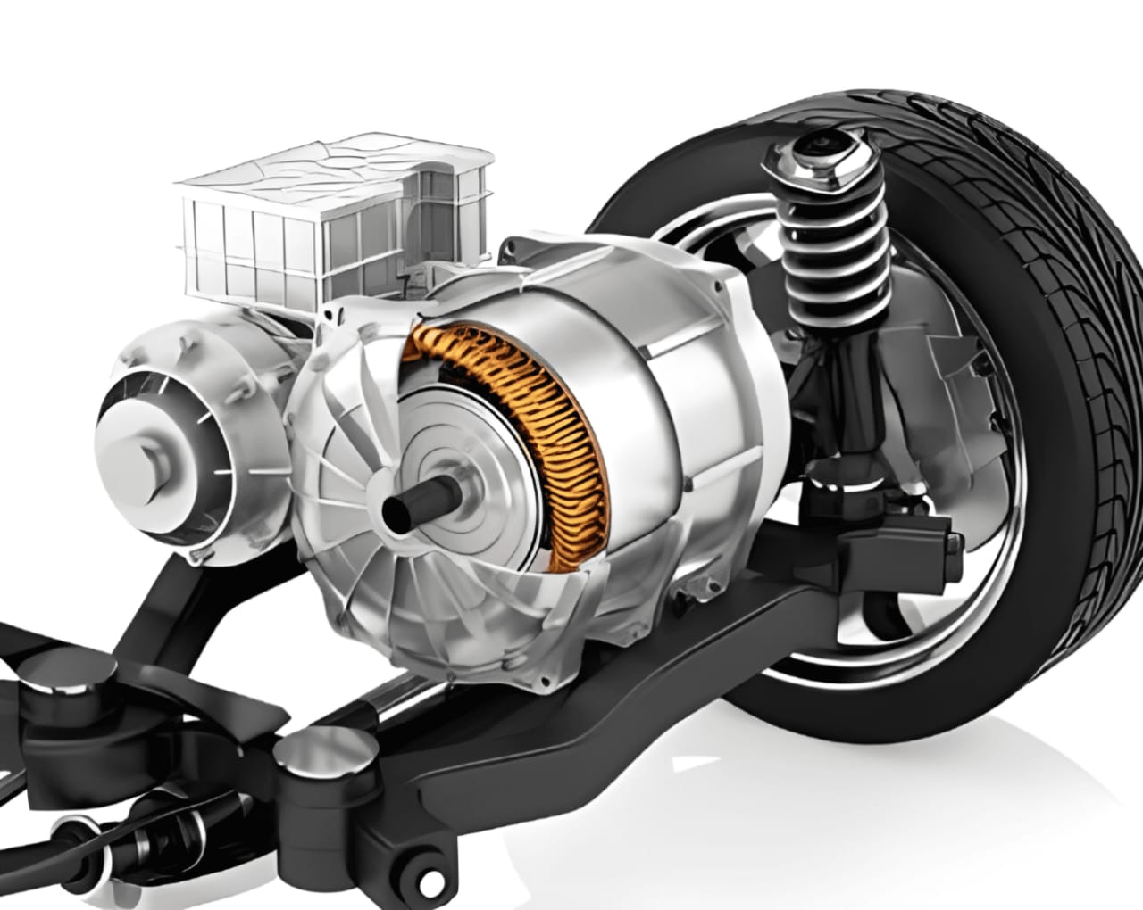
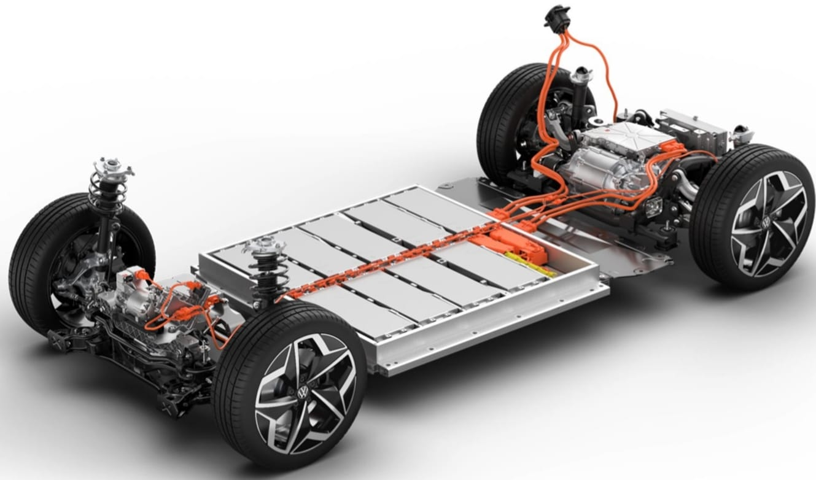
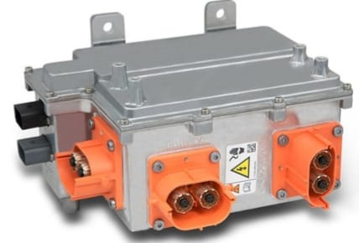
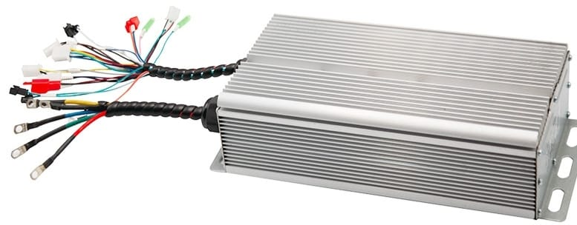
Motor
MAIN COMPONENTS IN EV’S
1. Electric Motor:
Converts electrical energy into mechanical energy to propel the vehicle.
By serving these purposes, electric motors play a crucial role in enabling EVs to operate efficiently, smoothly, and quietly.
2. Battery Pack:
The battery pack stores electrical energy that powers the vehicle
The battery pack supplies energy to the electric motor, enabling the vehicle to move.
3. Power Electronics Controller:
Regulate the flow of electrical energy between the battery, motor, and other components
Control the electric motor's speed, torque, and direction.
Monitor and protect the electrical system from overcurrent, overvoltage, and other potential faults.
Battery pack
PEC’s
8

Slide 9
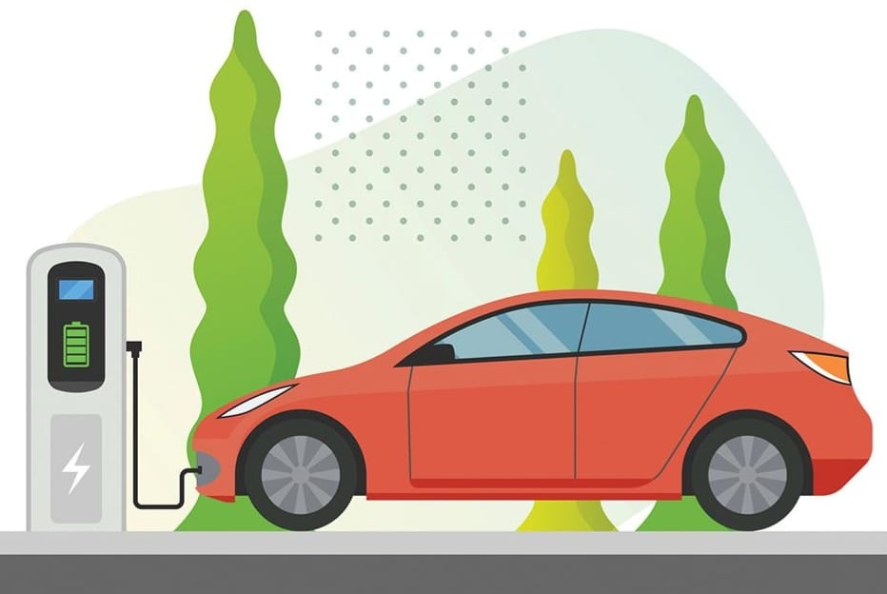
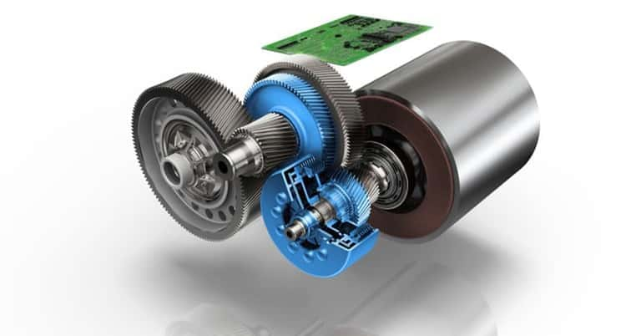
4. Charging System :
Allows the vehicle to recharge its battery from the external power
Uses a standard 120V AC outlet, suitable for overnight charging at home. Charging speed: 2-5 miles per hour.
Utilizes a 240V AC charger, commonly used for home and public charging stations. Charging speed: 10-25 miles per hour.
The fastest method, delivering high power directly to the battery. Charging speed: 60-100 miles in 30 minutes
Charging System
Transmission System
5. Transmission system :
In Electric Vehicles (EVs), the transmission system plays a role in transferring power from the electric motor(s) to the wheels. Unlike traditional internal combustion engine vehicles, EVs often use simpler transmission systems due to the electric motor's characteristics
9

Slide 10
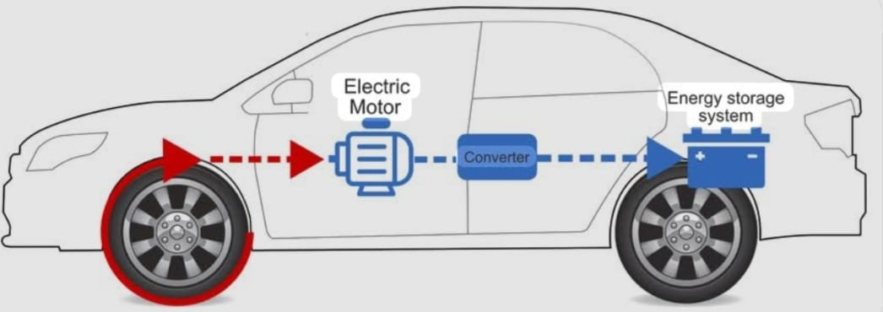
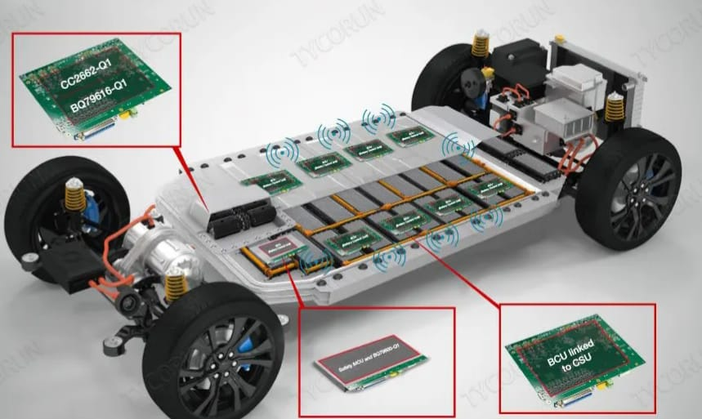
Regenerative Braking
6. Regenerative Braking System:
Regenerative braking is a key feature in Electric Vehicles (EVs) that captures kinetic energy generated during braking or coasting and converts it into electrical energy.
This energy is then stored in the vehicle's battery, improving overall efficiency and range.
Regenerative braking is a crucial technology in EVs, enhancing their efficiency, range, and overall performance.
Battery Management System
7. Battery Management System(BMS):
A Battery Management System (BMS) is a critical component in Electric Vehicles (EVs) that monitors and controls the battery pack's performance, ensuring safe and efficient operation.
The BMS plays a vital role in maintaining the health and performance of EV batteries, ensuring a safe and efficient driving experience.
10

Slide 11
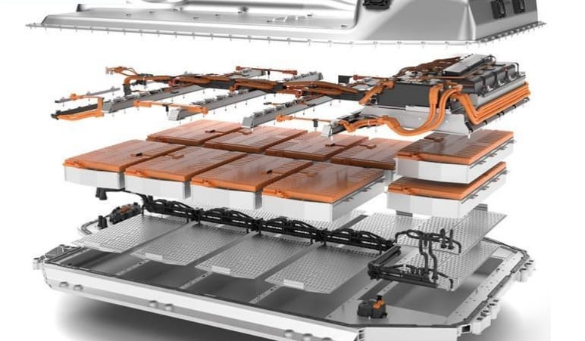
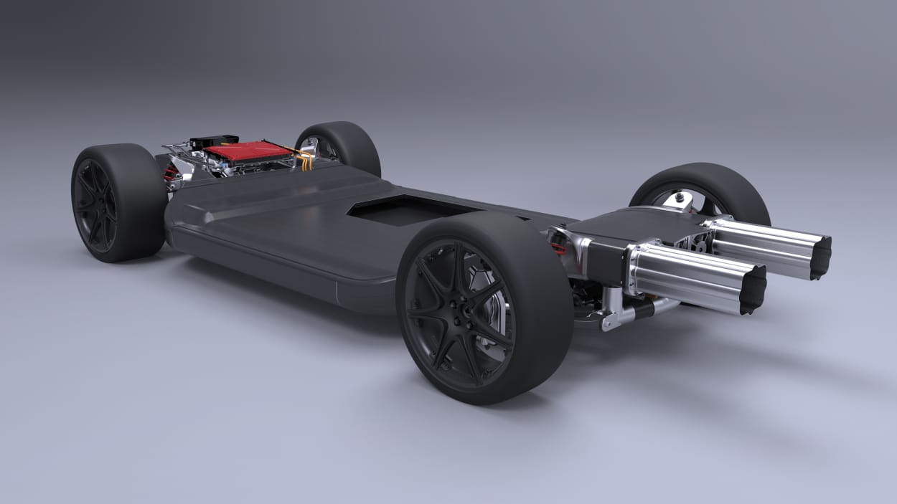
8. Thermal Management System :
Thermal management in Electric Vehicles (EVs) refers to the systems and techniques used to regulate the temperature of the battery, electric motor, and other components.
Effective thermal management is essential for ensuring the reliability, efficiency, and longevity of EV components.
Thermal Management System
9. Chassis :
The chassis and body of an Electric Vehicle (EV) provide structural support, safety, and aerodynamics.
The chassis and body of an EV are designed to optimize performance, efficiency, and safety while accommodating the unique requirements of electric powertrains
Chassis
11

Slide 12
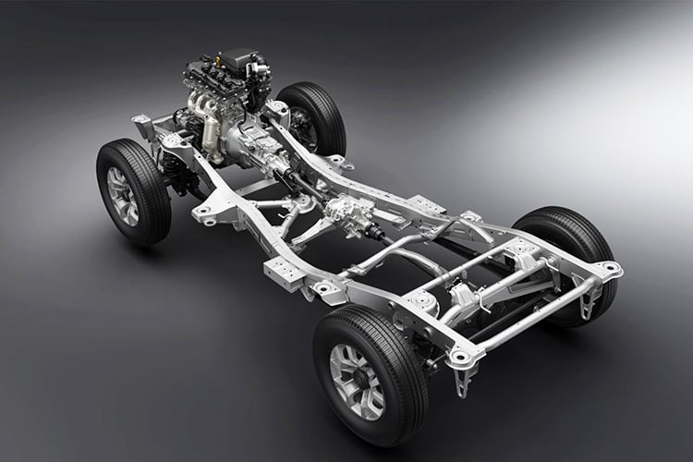
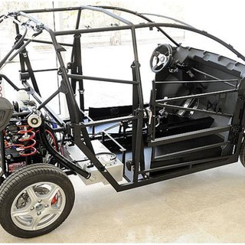
Explanation of Chassis Types and Functioning:
Ladder Frame Chassis
1. Ladder Frame: Derived from traditional vehicles, this chassis has two longitudinal beams linked by cross members. It provides strong structural support, suitable for heavy-duty EVs like trucks, but it is bulky and heavy, reducing efficiency and battery space.
2. Tubular Chassis: This chassis uses interconnected high-strength tubes forming a rigid framework. The tubes absorb and distribute stresses while minimizing weight, making it ideal for high-performance electric sports cars but expensive for mass production.
Tubular Chassis
12

Slide 13
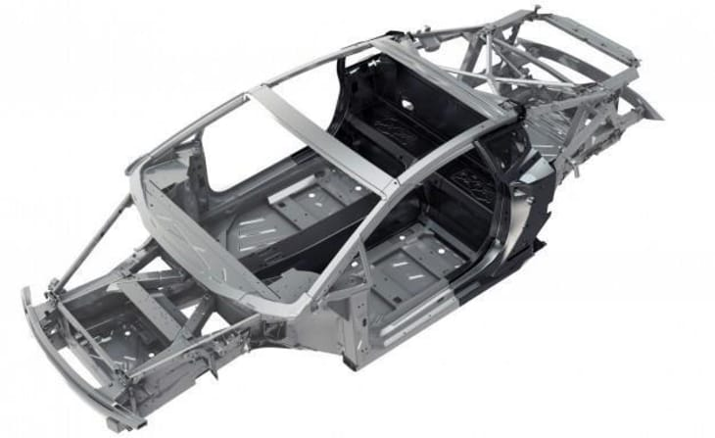
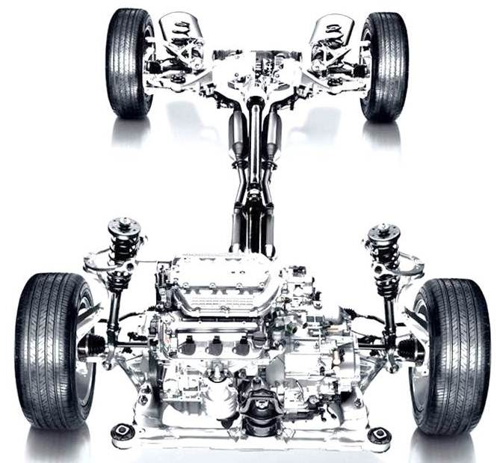
Monocoque Chassis
3 . Monocoque Chassis: Combines body and frame as a single structural unit, offering lightweight construction and high aerodynamic efficiency. It is widely adopted for passenger EVs but repairs post-accident are costly due to integrated structure.
Backbone Chassis
4 . Backbone Chassis: Features a central strong spine forming the main structural element with components mounted around it. It simplifies design and gives decent rigidity but doesn't optimize crash performance or internal space as well.
13

Slide 14
PRINCIPLE OF OPERATION:
The working principle of an electric vehicle (EV) is based on converting electrical energy stored in a battery into mechanical energy through an electric motor, which drives the wheels. When the vehicle is turned on and the accelerator pedal is pressed, the battery supplies direct current (DC) electricity to a controller, which regulates the power flow according to the driver's input. This power is then sent to an inverter, which converts DC into alternating current (AC) if required by the motor. The electric motor then uses this electrical energy to produce rotational motion, generating torque to move the vehicle. Unlike internal combustion engine vehicles, EVs do not rely on fuel combustion and produce zero tailpipe emission.
14

Slide 15
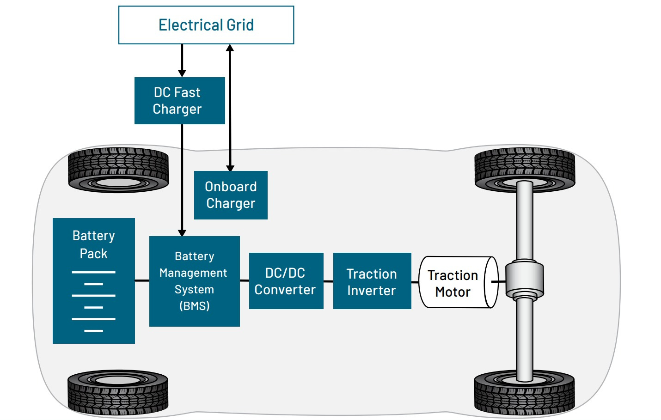
During braking or deceleration, EVs use a process called regenerative braking, where the electric motor works in reverse to convert some of the kinetic energy back into electrical energy, which is stored in the battery. The vehicle is recharged by plugging it into an external power source, and an onboard charger manages the conversion and storage of electricity. Overall, electric vehicles offer a cleaner, quieter, and more energy-efficient alternative to conventional vehicles.
Battery → Power Electronics → Electric Motor → Transmission → Wheels
15

Slide 16
Merits of the EV’s:
Zero tailpipe emissions → no CO₂, NOx, or particulate matter during operation . Helps reduce air pollution in cities . Supports the shift to clean energy when charged from renewable sources.
Energy Efficiency EVs convert about 85–90% of electrical energy into motion, compared to only ~30–35% for Internal Combustion Engines (ICE).Regenerative braking recovers energy that would otherwise be lost as heat.
Lower Operating Cost Electricity is generally cheaper than petrol or diesel . Fewer moving parts → reduced maintenance cost (no oil changes, fewer mechanical failures).
Performance Advantages Instant torque → smooth and quick acceleration . Quiet operation → reduced noise pollution . Lower center of gravity (due to battery placement) → better stability and handling.
Energy Independence Reduces dependency on fossil fuels . Promotes use of domestically produced renewable energy (solar, wind, hydro).
Technological Integration Smart connectivity with apps for monitoring battery, charging, and navigation . Integration with smart grids and potential for Vehicle-to-Grid (V2G) applications.
16

Slide 17
Demerits of EV’s:
High Initial CostEVs are generally more expensive than Internal Combustion Engine (ICE) vehicles due to battery costs.Though prices are falling, the upfront investment is still a barrier for many buyers.
Limited Driving RangeEVs usually have a shorter range compared to petrol/diesel vehicles.“Range anxiety” (fear of running out of charge before reaching a charging station) is a common issue.
Charging InfrastructureLack of widespread charging stations in many areas.Charging takes longer than refueling at a petrol station (even with fast chargers, it’s not instant).
Charging TimeStandard home charging can take 6–12 hours.Fast chargers reduce this but can still take 30–60 minutes to get ~80% charge.
Battery IssuesHigh battery replacement cost (though rare within warranty period).Battery degradation over time reduces range and performance.Concerns over battery recycling and disposal (environmental challenge).
Limited Model AvailabilityFewer model choices compared to ICE vehicles, especially in lower price segments or specific vehicle types (e.g., trucks, buses in some regions).
17

Slide 18


